Slide 1


Supply Chain Management
Project:
A Study on Walmart’s SCM

Slide 2
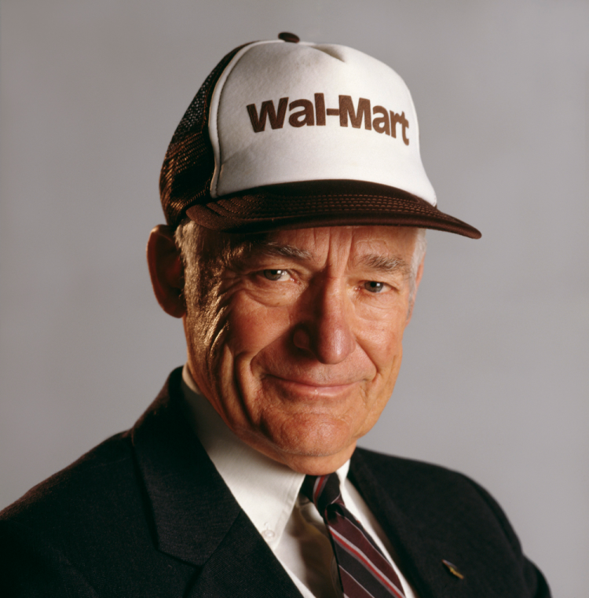
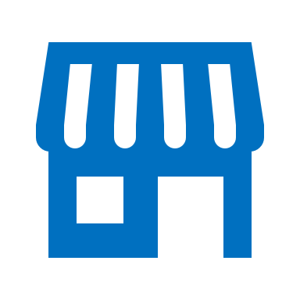
“People think we got big by putting big stores in small towns. Really, we got big by replacing inventory with information.” -Sam Walton, Founder of Walmart

Slide 3
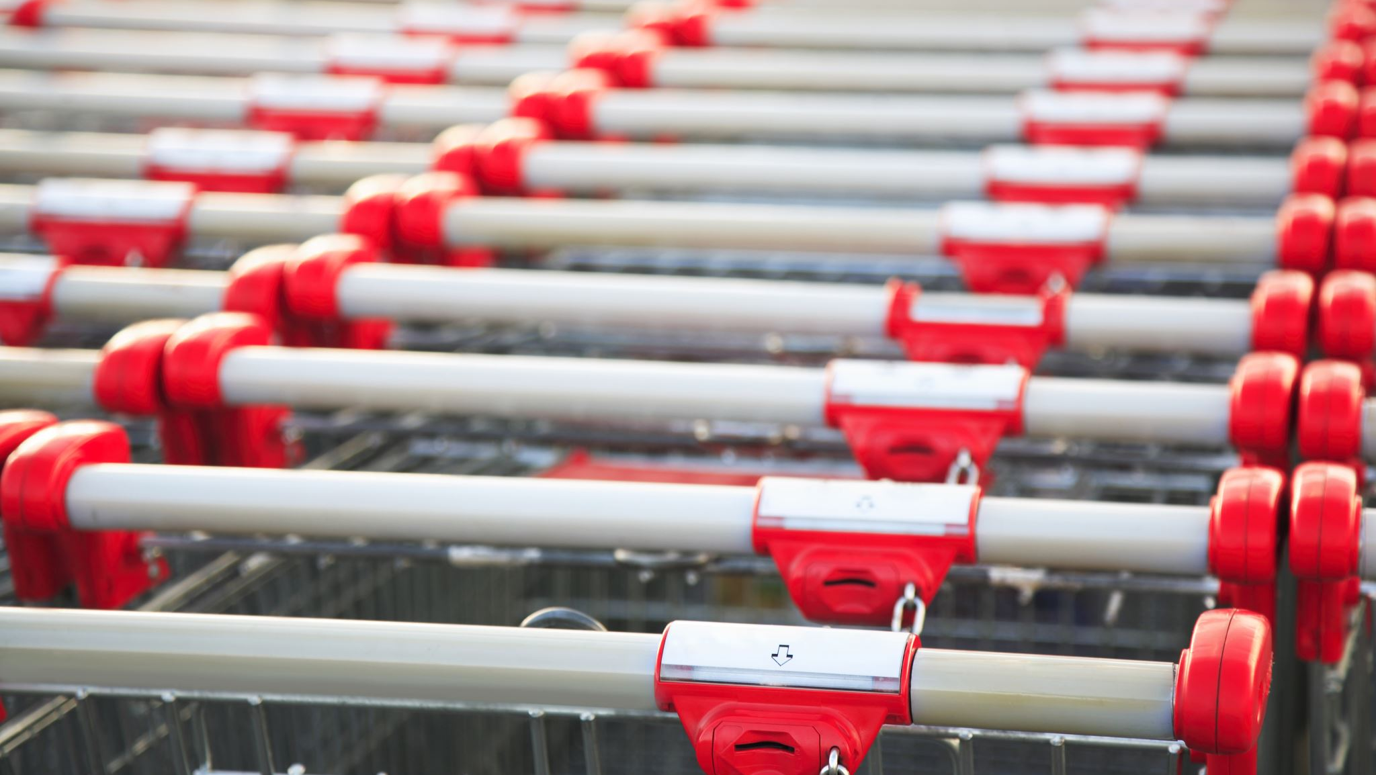
About Walmart
Founded | 1962
Founder | Sam Walton
Industry | Retail
Number of Stores/locations | 10,585 stores (2022)
Number of Countries operating in | 24
Net Revenue | USD $ 572.75 billion (2022)
Net Income | USD $ 13.673 billion (2022)
Employee | 2.3 million
Fun Fact about Walmart:
Average Profit - $ 1.8 million per hour.
On average around 37 million people visit Walmart stores each day!! (2020)
90% of Americans live within 15 minutes of a Store.

Slide 4

Target Market
Walmart’s targeted Demographics:
Modest income families who want a one-stop solution
Shoppers interested in prices
Largest % of shoppers : age 24-45
Shift in customer base over the past few years:
Online Shopping (79% increase due to Pandemic)
Gen-Z coming of age

Slide 5
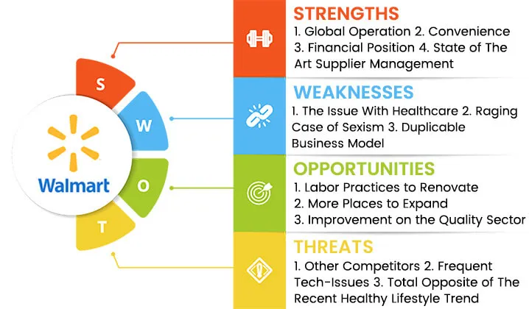
Walmart as a Company
Walmart Strategies
“Everyday low price”
Effective use of logistics management
Effective inventory control
Bargaining power over suppliers
Global Expansion for new market opportunity

Slide 6
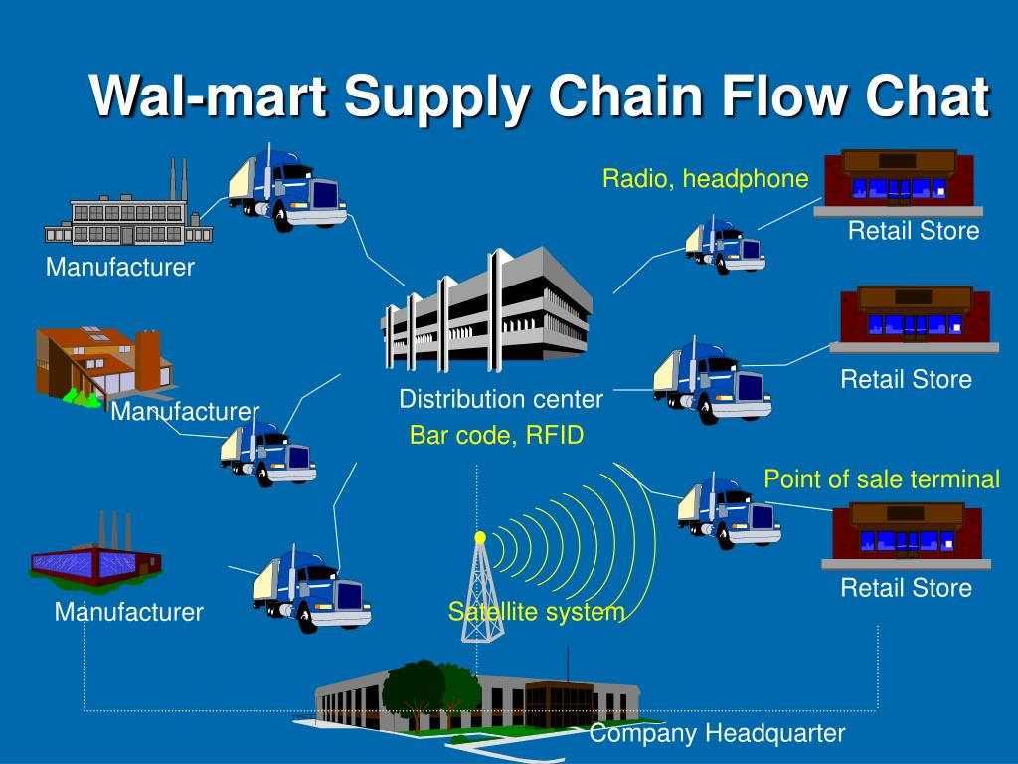
Components of SC:
Procurement
Distribution
Logistics Management
Inventory Management
Notes:
GPS in every truck, Any truck can be located, and Driver can activate it via voice and interact with staff.

Slide 7
Walmart’s Primary Activities
Inbound Logistics | Operations | Outbound Logistics | Marketing and Sales | Service
VMI system (Vendor managed inventory) Continuous Replenishment EDI (Electronic Data Interchange) | 3 Business segments: Walmart stores Super centers Discount centers Neighborhood markets Sam’s Club Walmart International | Hub and Spoke distribution system. Cross Docking: Logistic technique to make the distribution process more efficient | Word of mouth communication Focus on everyday low price “Save money, live better” Sales are on a self-service, cash-and-carry basis | Accepting returned goods Satisfaction guarantee Opening hours (24/7)

Slide 8
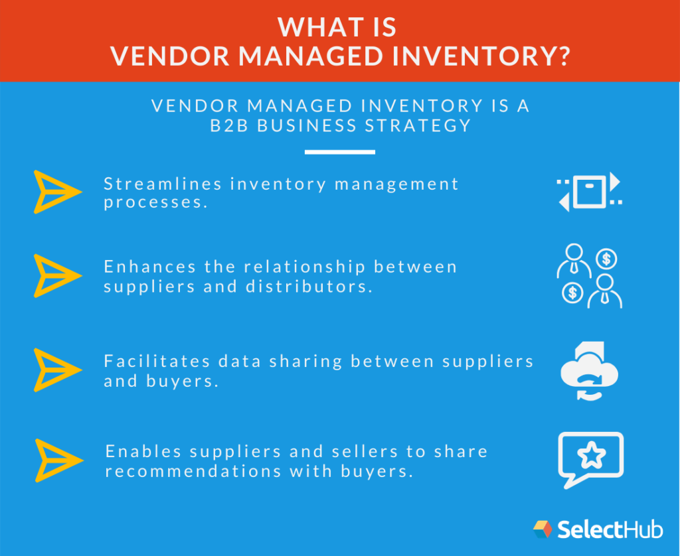
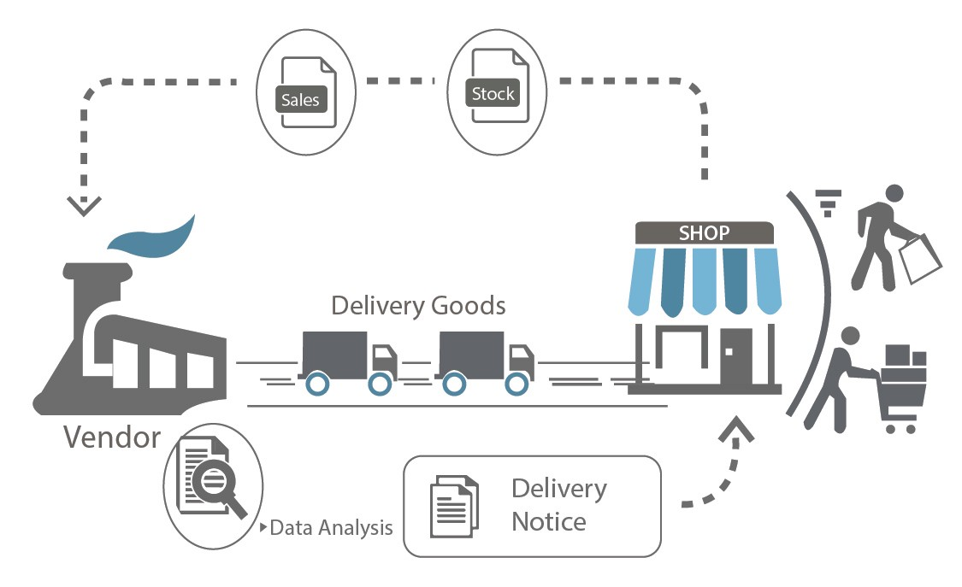
Inbound Logistics
The vendor (supplier) manages the stock levels and availability for the customer based on safety stock levels the as per the agreed Terms & Conditions.

Slide 9
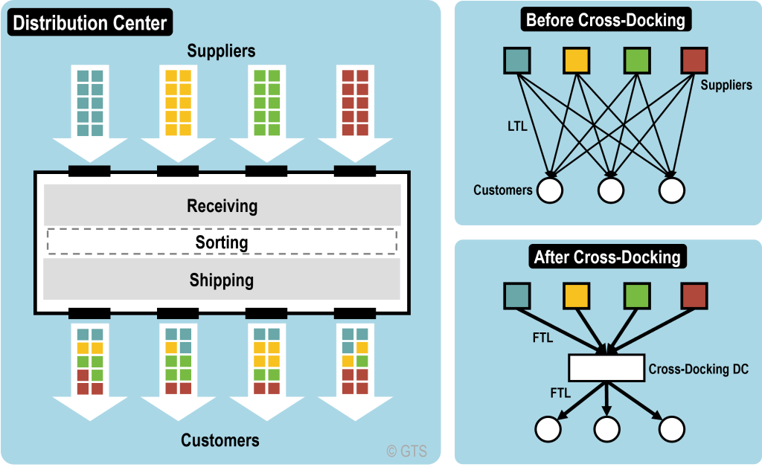

Distribution Channel
“Saturation Strategy”
The company owns a fleet more than 10,000 trucks and 80,000 trailers.
The Wal-Mart Way: Cross-Docking

Slide 10
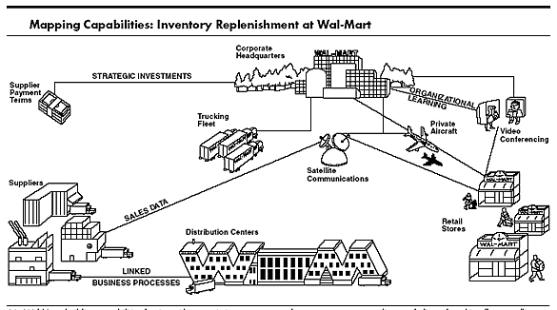
Communication Network
Cross Docking relies on continuous communication between Wal Mart’s suppliers, distribution centers, and every point-of-sale system in each store.
This enables orders to flow in, get packaged and then shipped
How do they do it ?
Wal Mart operates their own satellite network.
Wal Mart’s satellite network sends the point of sale (POS) data directly to 4000 vendors

Slide 11
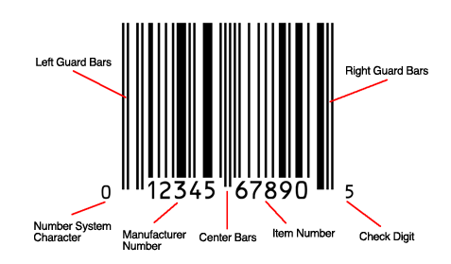
Inventory Management
Through POS system for tracking sales and stock level.
Uses sophisticated algorithm enables them to forecast exact quantity of inventory needed to restock.
Centralized data system to monitor inventory and location of product at any point of time
Walmart’s Retail link enables suppliers to monitor the sales of their goods
First company to push for “Universal Product Code bars”
Inventory Management through RFID

Slide 12
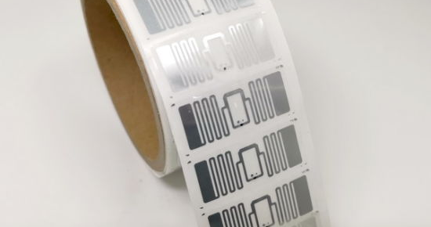
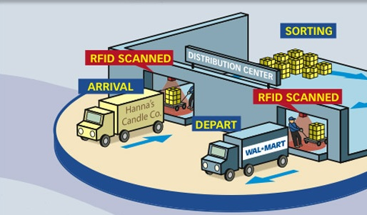
Wal-Mart replaced bar-code technology with RFID technology to reduce costs and increase the efficiency, in July 2003, and asked its top 100 suppliers to be RFID compliant by January 2005.
RFID in Walmart
Automated Data collection based on an electronics – not a barcode
Tag can be imbedded in the product or stuck on the exterior case or pallet
Reader instead of a barcode scanner
Allows fully automated data collection with the use of portals
Can read many ID tags at a time

Slide 13
Pricing Strategies
Everyday low prices (EDLP) - prices on items at relatively low compared to the everyday market price (maintaining customer trust in pricing and customer loyalty)
Additionally, to their traditional Bricks-and-Mortar, Clicks and bricks model - allows the customer to order products either online or physically in one of their stores, also allowing them to either pick-up their order directly at a local branch of the store or get it delivered to their home
“Price match guarantee“, it has challenged other competitors to reduce their pricing (PMG: if a consumer brings in some sort of proof that a competitor is offering the same product at a lower price, the business will allow the consumer to purchase that product from them at that lower price)

Slide 14
How lowest price?
1. Huge sales volume, scope of operation and wide customer base
Selling almost everything and being almost everywhere. Multiple-store format that extends its market reach, and it sells goods through four types of stores: discount stores, Walmart Supercenters, Sam's Club warehouses (which sell bulk items), and neighborhood markets.
2. SCM based on maximizing efficiency and reducing outlays
Walmart was a pioneer in getting detailed product information electronically attached to products so that such information could be relayed to its database and could inform its inventory management system.
The goal - to master the art of knowing
what is needed?
how much is needed? and
when is it needed?

Slide 15
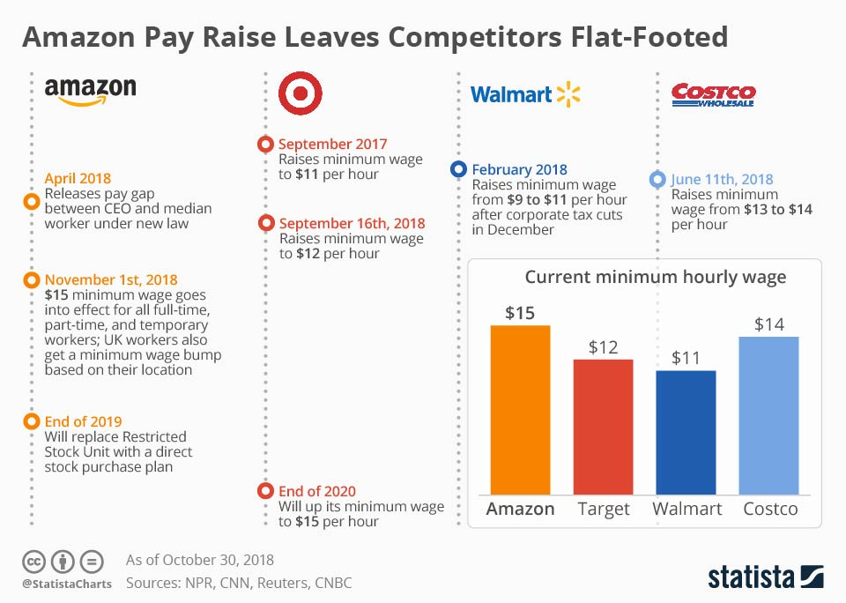
How Lowest Price ?
3. Minimization of overhead and operational costs
Walmart saves money on everything, including the labor costs.
Meager wages,
Low-benefit healthcare plans,
Executives fly coach and share hotel rooms with colleagues.
Hourly workers put in overtime without pay.
Each Walmart associate does the job of 1.5 to 1.75 employees of a rival.
Saving on heating and cooling of the buildings

Slide 16
How Lowest Price ?
4. Leveraging of Its bargaining power to force suppliers to lower prices
The Walmart Effect - as the biggest buyer Walmart is constantly pushing its suppliers to cut prices.
Case: Lakewood Engineering & Manufacturing Company
In the early 1990s the cost of a 20-inch fan was $20. After Walmart pushed for the lowering of the price, Lakewood automated its production process, which resulted in the layoff of workers. It also put pressure on its own suppliers to slash the prices of parts, and it opened a factory in China where workers earned 25 cents an hour. By 2003, the price of a fan in Walmart had dropped to $10.

Slide 17
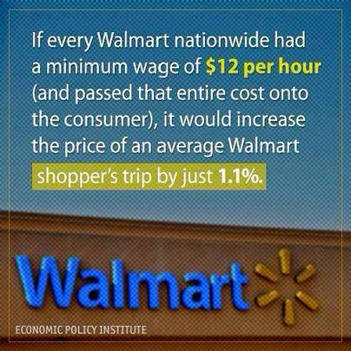
Existing Problems / Challenges
Treatment of their Employee
Expansion to other countries Very limited in Asia and Europe, can further expand to developing countries.
Relatively low profit margin Due to low-cost end products, relies on sheer volume to earn profits.
Faces tough competition other e-commerce giants such as Amazon.
Notes:
Have faced lawsuit for low wage, lack of healthcare and negative environment for staff can reflect in customer experience, need to improve public image and reputation.
Low margin due to pricing strategies, can capture market but may be wise to slowly include premium range of products for consumers who’re willing to pay more
In person sales are slowly declining, need to improve online shopping capabilities and delivery service to stay relevant.

Slide 18
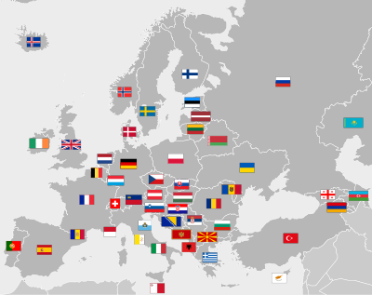
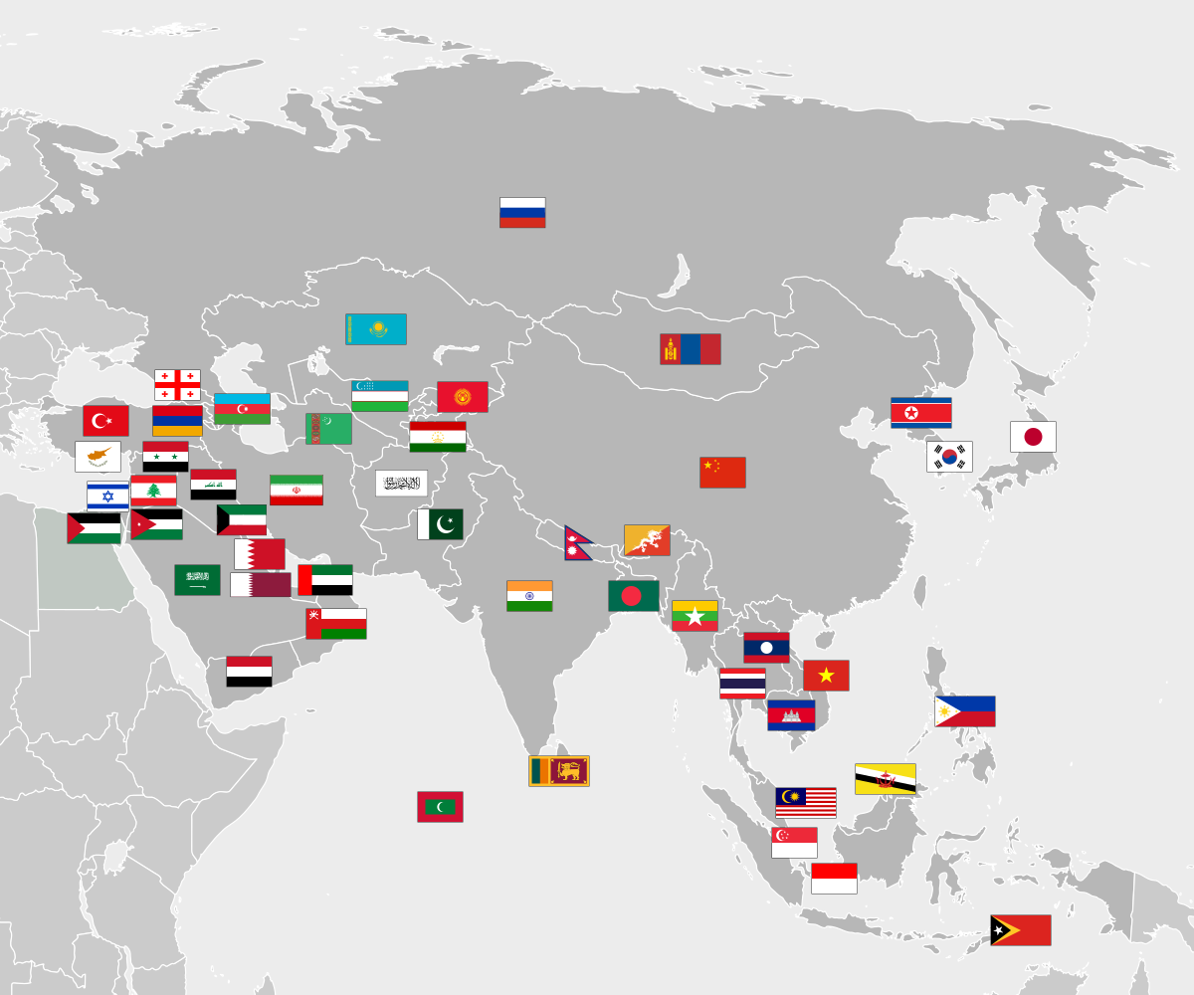
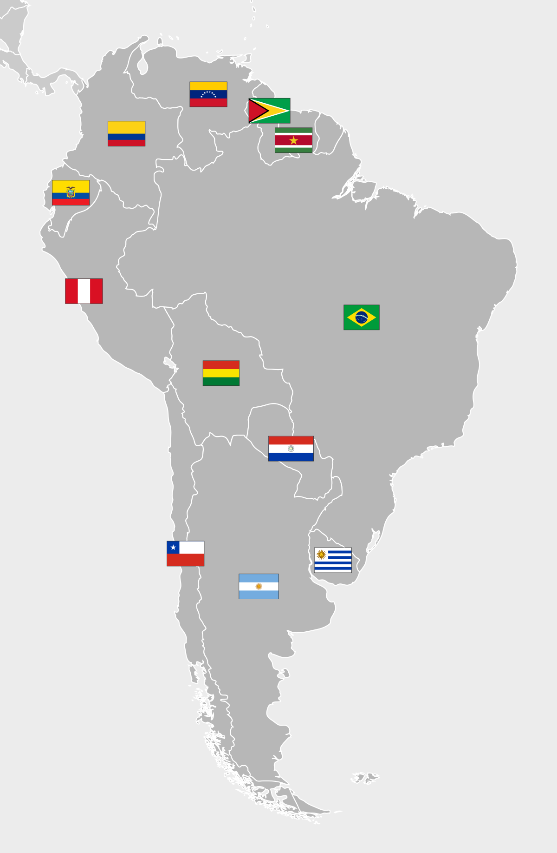
Suggestions and Recommendations
Markets to enter
Europe: - Mature market - High Rivalry - Lack of strong Consumer relationship
Asia: - Most distant geographically - Most different culturally and logistically - Requires high financial and managerial resources
Latin America: - Closest Market - Large Population - Emerging Markets
Notes:
Saturated domestic market, stagnating growth in US market
US only represents ~4% of world’s population, need to capture the rest
Emerging markets with lower disposable income offer a huge platform for growth
Higher growth, revenue and Economies of scale due to global buying power
Pre-empt other competitors from entering
Most international success in Mexico and Canada which were close

Slide 19
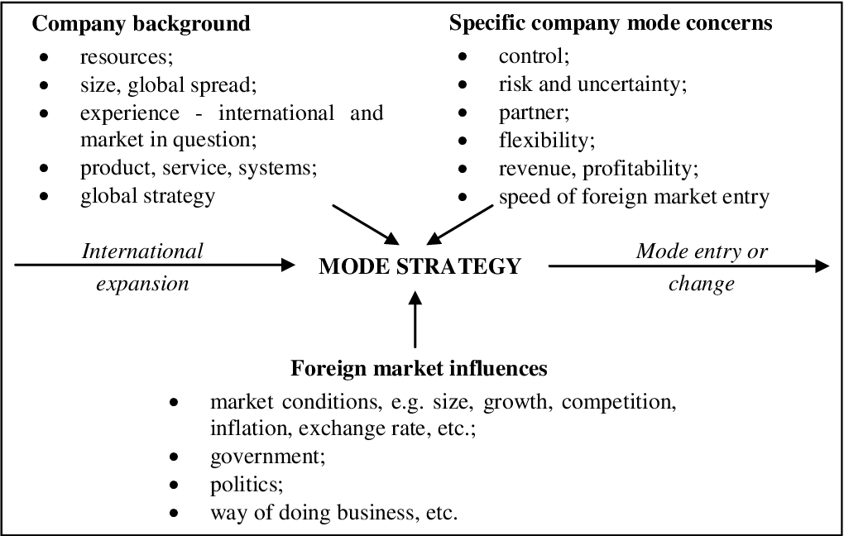
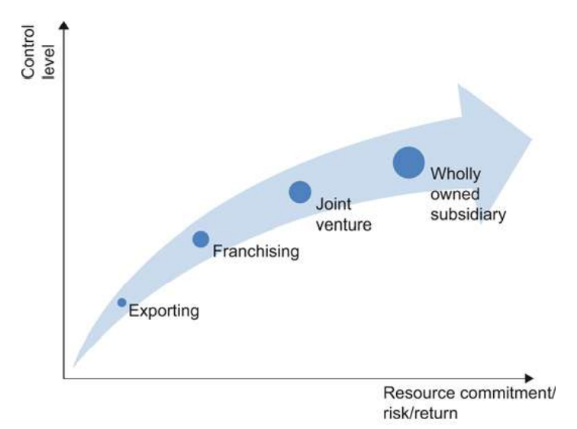
Mode of Entry for International Expansion

Slide 20

Taking Steps..
Walmart Express Deliveries and Walmart+ Taking on Amazon with deliveries within 2hrs, and unlimited grocery deliveries and free shipping.
Renovating store to miniature warehouses – swiftly process online orders or curbside pickup using robotics or staff.
Walmart’s sustainable hub – pledged to reduce greenhouse emission by 1 billion metric ton by 2030
Working on self driving vehicles and automated item identification.
Working on a better environment for staff with pay hikes, and possible promotion to leadership position.
Altering store design to make them more engaging, plan to include brand store, more displays, samples and QR to point to alternatives.
Expanding their in-home delivery program – highly skilled worker to deliver goods straight to your kitchen.

Slide 21

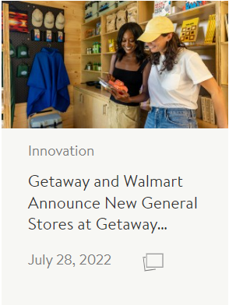
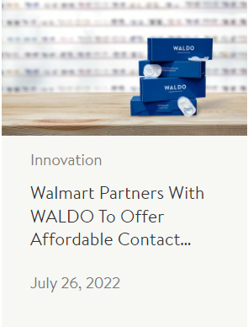
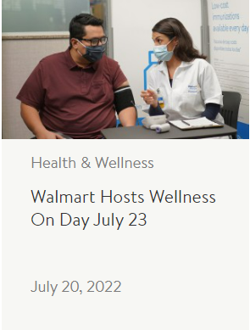
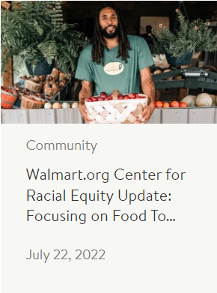

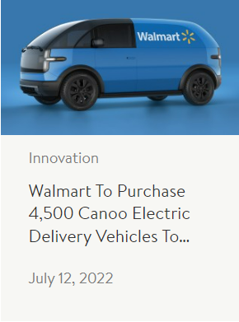
What’s new..?

Slide 22
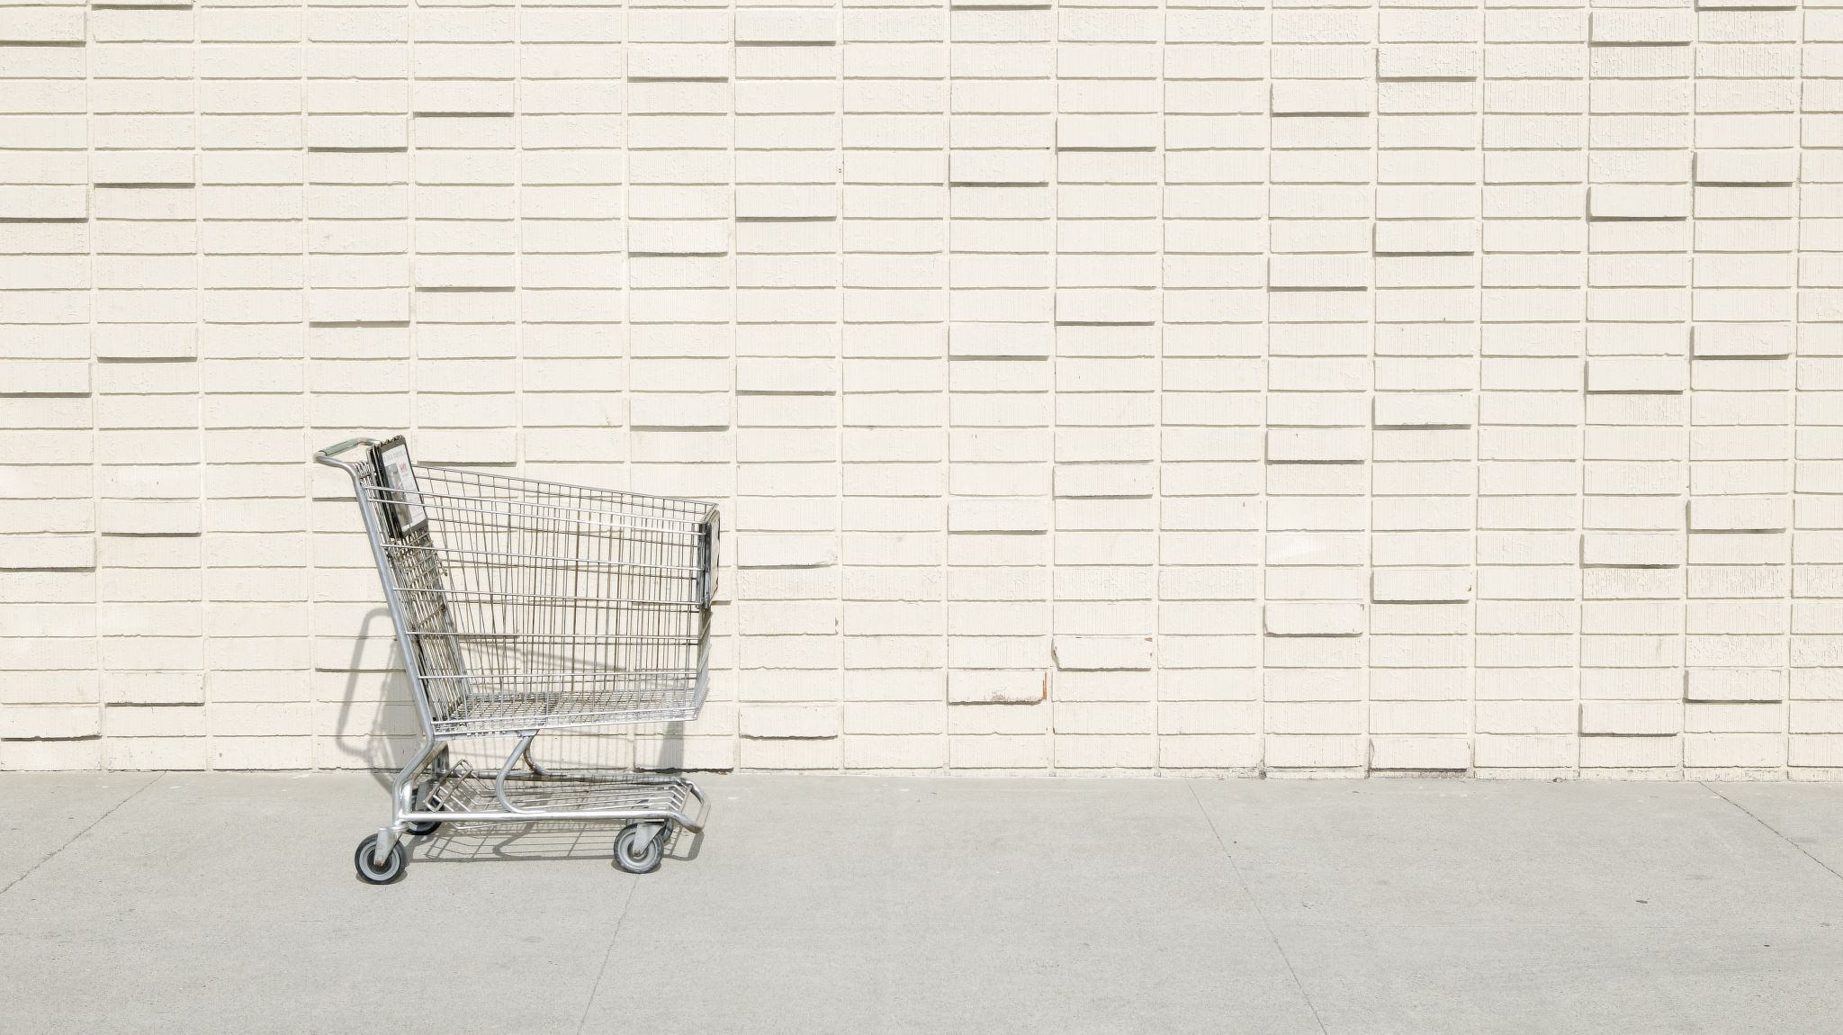
Thank You !
Karthick Sharan

